Slide 1
Fast and Customized Data Loaders

Slide 2
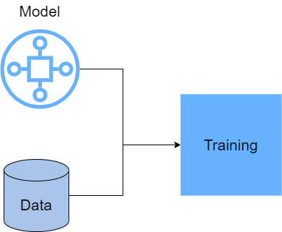
Machine Learning Training

Slide 3
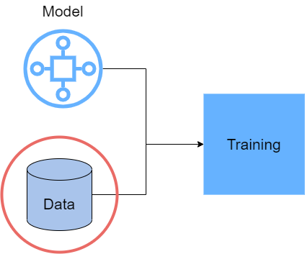
In this section we will investigate loading and processing different kinds of data in TensorFlow.

Slide 4
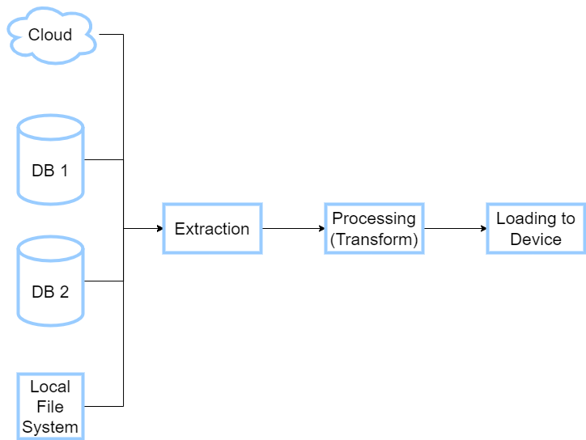
ETL

Slide 5
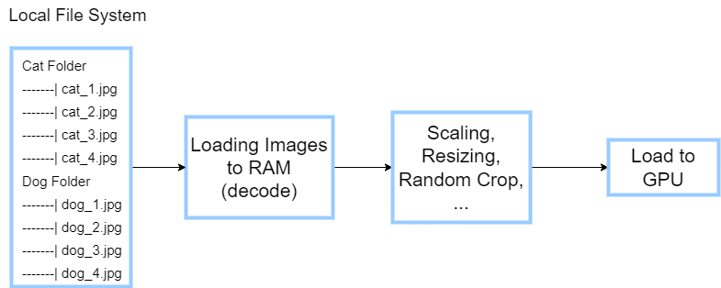
Images as an Example

Slide 6
Approach 1 (Using Common Data Structures)
Extract All Images with PIL or OpenCV into Numpy Arrays
Apply Transformation with Numpy Operations
Load Processed data into GPU with TensorFlow Tensors

Slide 7
Problems with This Approach
RAM Capacity Shortage
Data
RAM

Slide 8
Problems with This Approach
2. Speed of data processing compare to Machine Learning Accelerators (GPU, TPU)

Slide 9

Speed Problem
Your GPU

Slide 10

Speed Problem
Your Data Loader

Slide 11
Here It Comes …
tf.data

Slide 12
tf.data is a powerful API to build fast and flexible data pipelines.
It supports different kinds of data: image files, CSV, TF Records, Text, etc.
It is Fast because of Parallel computation.
It is Intuitive and Simple

